Slide 1
INTRO TO LOGISTIC REGRESSION

Slide 2
LEARNING OBJECTIVES
Understand Logistic Regression & decision boundaries
Evaluate a model using metrics such as classification accuracy/error, confusion matrix, ROC/AUC curves, and loss functions
Build a Logistic Regression using sci-kit-learn library

Slide 3

WHAT IS LOGISTIC REGRESSION?
A linear approach to solving a classification problem.
It will use a linear regression style approach to predict the class of an item yet retain the interpretability of linear regression model.

Slide 4
WHY NOT
LINEAR REGRESSION?

Slide 5
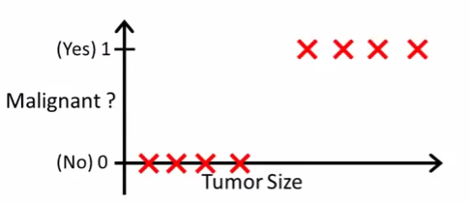
LINEAR REGRESSION?
Motivation: suppose we want to predict whether a tumor is malignant or benign based on its size.
Decision Boundary
Find where y = 0.5 => x = 2
Anything larger than 2 we will classify as a malignant tumor
Anything less than 2 we will classify as a benign tumor

Slide 6
LINEAR REGRESSION?
Would Linear Regression work?
Decision Boundary
Find where y = 0.5 => x = 2
Anything larger than 2 we will classify as a malignant tumor
Anything less than 2 we will classify as a benign tumor
0.5
X = 2
What types of problems can you foresee with this technique?

Slide 7

LINEAR REGRESSION?
Problem 1
Suppose we have another training example, p
Because OLS is minimizing the residuals, it stretches out the line and moves our decision boundary!
These points are now classified as benign!
P
0.5
X = 6

Slide 8
LINEAR REGRESSION?
Problem 2
Linear Regression outputs predictions < 0 or > 1
Decision Boundary
We want a model that predicts values between 0 and 1
We want a decision boundary AKA “anything past this is class A and anything before it is class B”

Slide 9
LOGISTIC REGRESSION

Slide 10
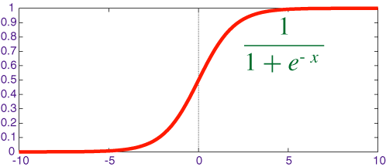
WHY DO WE USE LOGISTIC REGRESSION?
We will use Logistic Regression to predict a binary response (0 or 1).
We use the Sigmoid/Logistic function to output probabilities for our predictions.
This is called our Link function.
We need it in order to find optimal parameters in our model
A standard rule is to classify our “1” class as anything with a probability > 0.5 and our “0” class anything below that.
The point at which the probability = 0.5 is called the decision boundary.

Slide 11
TRANSFORMING LINEAR REGRESSION
Intuition: the “linearity” of logistic regression is in the decision boundary we develop. You can imagine it as a line (in 2-D) that separates the two classes.
X2
X1
How do we develop this line and what’s the criteria for it? How does it relate to the Sigmoid function?

Slide 12
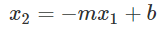
TRANSFORMING LINEAR REGRESSION
Question: how do we develop the decision boundary?
X2
Layman’s definition
We fit a line that best “divides” the two classes
Mathematical definition
We fit a line such that we minimize the sum of the residuals between the true label and the “strength” (aka probability) of our guess.
X1

Slide 13
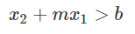
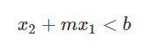
TRANSFORMING LINEAR REGRESSION
X2
We can also rewrite the equation as this:
If then we predict 1.
if then we predict 0
X1

Slide 14
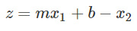
TRANSFORMING LINEAR REGRESSION
Question: how does our decision boundary relate to the sigmoid function?
X2
Where
X1
The sigmoid function outputs values from [0,1] that represent the “strength” aka probability of our prediction

Slide 15
TRANSFORMING LINEAR REGRESSION
It will limit our range to [0,1] and create the right shape for our regression line to match the categorical outcome variable.

Slide 16
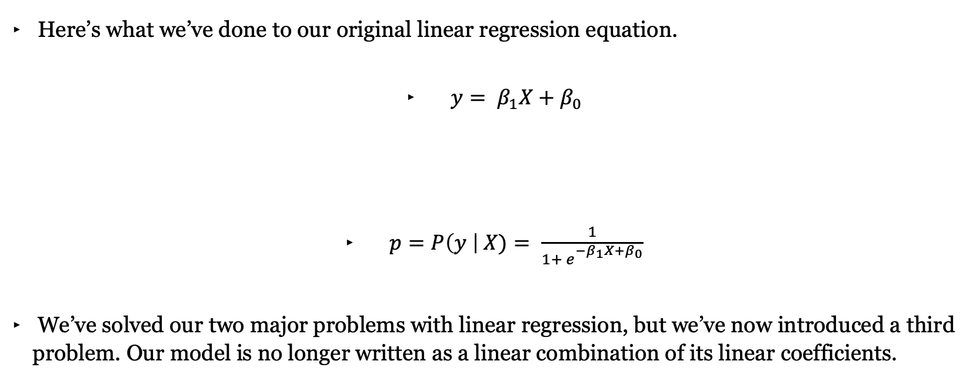
TRANSFORMING LINEAR REGRESSION
Here’s what we’ve done to our original linear regression equation.
$y= β_{1}X+β_{0}$
$p=P\left(y \right| X)= \frac{1}{{1+ e}_{}^{−β_{1}X+β_{0}}}$
We’ve solved our two major problems with linear regression, but we’ve now introduced a third problem. Our model is no longer written as a linear combination of its linear coefficients.

Slide 17
INTERPRETING
LOGISTIC REGRESSION

Slide 18
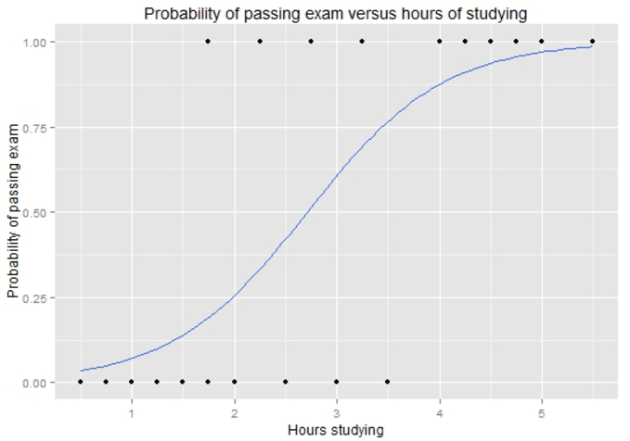

TRANSFORMING LINEAR REGRESSION
Example: how does the number of hours spent studying affect the probability that the student will pass the exam?
18 | © 2019 General Assembly

Slide 19
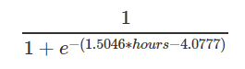
TRANSFORMING LINEAR REGRESSION
Example: how does the number of hours spent studying affect the probability that the student will pass the exam?
19 | © 2019 General Assembly

Slide 20
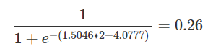
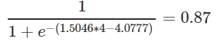
TRANSFORMING LINEAR REGRESSION
For a student who studies 2 hours, the equation gives an estimated probability of passing an exam at 0.26:
While someone that studies for 4 hours, their probability of passing is 0.87:
0.87
0.26
Standard rule is to predict the “1” class if the probability > 0.5
20 | © 2019 General Assembly

Slide 21
TRANSFORMING LINEAR REGRESSION
Standard rule is to predict the “1” class if the probability > 0.5
What would you predict for a student that studies 2 hours?
What would you predict for a student that studies 4 hours?
0.87
0.26
21 | © 2019 General Assembly

Slide 22
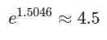
TRANSFORMING LINEAR REGRESSION
How do we interpret the coefficients?
For every 1 hour increase in studying, a student multiplies their odds of passing an exam by:
**Bottom line:** Positive coefficients increase the log-odds of the response (and thus increase the probability), and negative coefficients decrease the log-odds of the response (and thus decrease the probability).
22 | © 2019 General Assembly

Slide 23
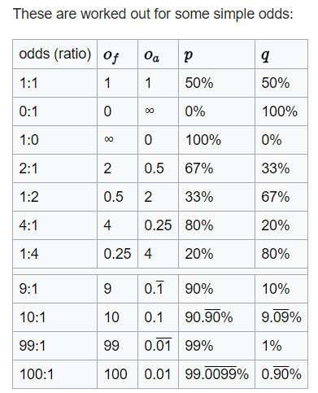
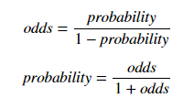
TRANSFORMING LINEAR REGRESSION
Odds represent the likelihood that an event will take place.
What would be the odds for an event with a p = 0.75?
What about the odds for something with a p = 0.40?
23 | © 2019 General Assembly

Slide 24
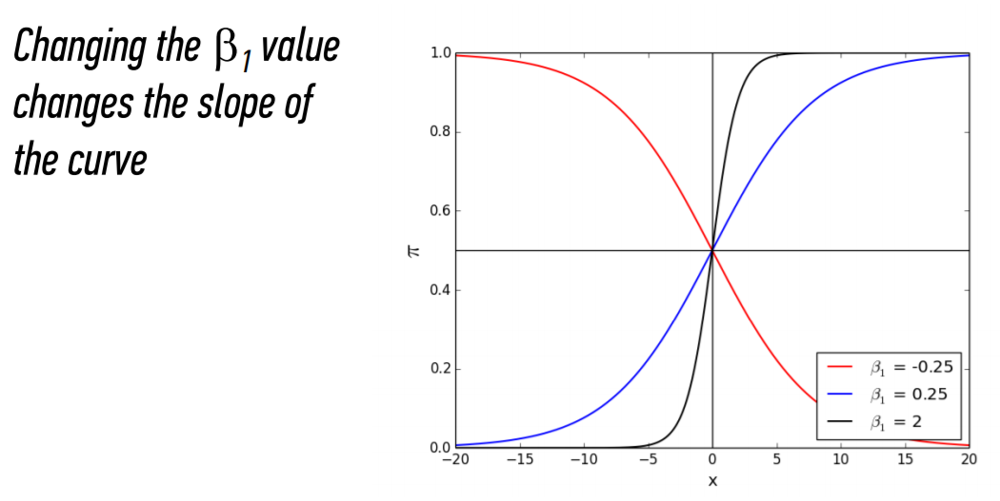
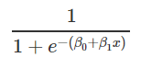
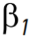
TRANSFORMING LINEAR REGRESSION
The bigger the
the steeper the curve
The smaller the more gradual the curve
24 | © 2019 General Assembly

Slide 25
PROBABILITY RECAP
Probability is the probability an event happens. For example, there might be an 80% chance of rain today.
Odds (more technically the odds of success) is defined as probability of success/probability of failure. So the odds of a success (80% chance of rain) has an accompanying odds of failure (20% chance it doesn’t rain); as an equation (the “odds ratio“), that’s .8/.2 = 4.
Log odds is the logarithm of the odds. Ln(4) = 1.38629436 ≅ 1.386.

Slide 26
ADVANTAGES AND DISADVANTAGES
Advantages of logistic regression
Highly interpretable (if you remember how)
Model training and prediction are fast
No tuning is required
Features don't need scaling
Can perform well with a small number of observations
Outputs well-calibrated predicted probabilities
Disadvantages of logistic regression
Presumes a linear relationship between the features and the log-odds of the response
Can't automatically learn feature interactions
26 | © 2019 General Assembly

Slide 27
MULTICLASS
LOGISTIC REGRESSION

Slide 28
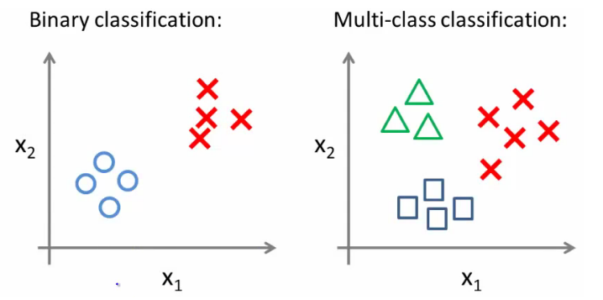
MULTICLASS LOGISTIC REGRESSION
Multiclass has more than yes or no, there are multiple classes for assignment.

Slide 29
ONE VS. ALL CLASSIGICATION
Split the training set into 3 separate binary classification problems.
Make predictions based on which ever model outputs the highest probability for y=1
X2
X2
X2
X1
Circle vs. everything else (squares and triangles)
Squares vs. everything else (circles and triangles)
Squares vs. everything else (circles and triangles)

Slide 30
ADVANCED CLASSIFICATION METRICS

Slide 31
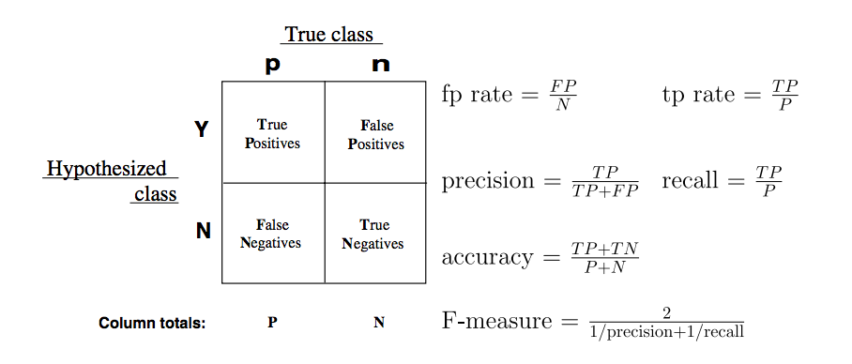
CONFUSION MATRIX
Confusion matrices allow for the interpretation of correct and incorrect predictions for each class label.

Slide 32
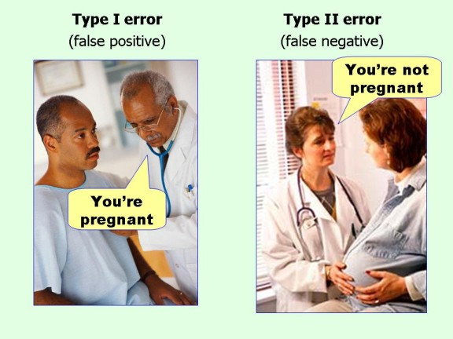
ERROR TYPES
32 | © 2019 General Assembly

Slide 33
CONFUSION MATRIX
Confusion matrices allow for the interpretation of correct and incorrect predictions for each class label.
Predictions
Not Pregnant
Pregnant
What are the number of true positives?
What are the number of false negatives?
What are the number of false positives?
What are the number of true negatives?
50 | 24
10 | 62
Not Pregnant
Pregnant

Slide 34
TRUE POSITIVE RATE
The true positive rate (TPR) measures the proportion of actual positives that are correctly identified as such (e.g., the percentage of sick people who are correctly identified as having the condition).
Notes:
TP/(TP+FN)

Slide 35
FALSE POSITIVE RATE
The false positive rate (FPR) is calculated as the ratio between the number of negative events wrongly categorized as positive (false positives) and the total number of actual negative events (regardless of classification).
Notes:
FP/(FP+TN)

Slide 36
PRECISION AND RECALL
Precision and recall, metrics built from the confusion matrix, focus on information retrieval, particularly when one class is more interesting than the other.
For example, we may want to predict if a person will be a customer. We care much more about people who will be a customer of ours than people who won’t.

Slide 37
PRECISION AND RECALL
Precision aims to product a high amount of relevancy instead of irrelevancy.
Precision asks, “Out of all of our positive predictions (both true positive and false positive), how many were correct?”
Recall aims to see how well a model returns specific data (literally, checking whether the model can recall what a class label looked like).
Recall asks, “Out of all of our positive class labels, how many were identified?”

Slide 38
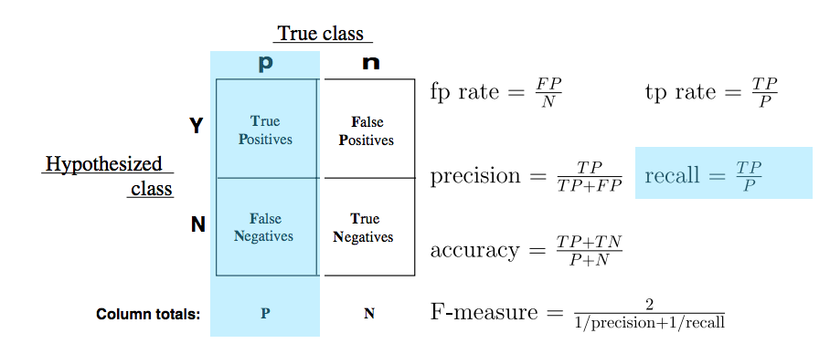
RECALL
Recall is the count of predicted true positives over the total count of that class label.
This is the same as True Positive Rate or sensitivity.
38 | © 2019 General Assembly

Slide 39
RECALL
Imagine predicting the color of a marble as either red or green. There are 10 of each.
If the model identifies 8 of the green marbles as green, the recall is 8 / 10 = 0.80.
However, this says nothing of the number of red marbles that are also identified as green.
39 | © 2019 General Assembly

Slide 40
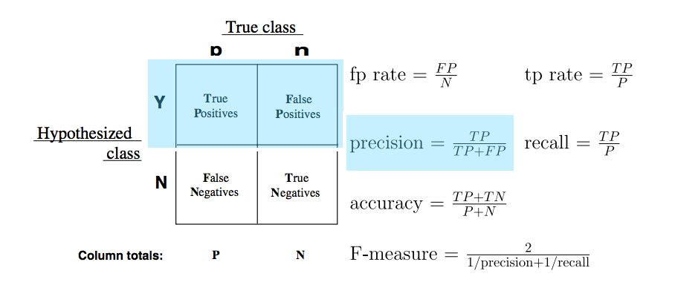
PRECISION
Precision, or positive predicted value, is calculated as the count of predicted true positives over the count of all values predicted to be positive.
40 | © 2019 General Assembly

Slide 41
PRECISION
If a model predicts 8 of the green marbles as green, then precision would be 1.00, because all marbles predicted as green were in fact green.
Let’s assume all red marbles were predicted correctly, and 2 green were predicted as red.
The precision of red marbles would be 10 / (10 + 2) = 0.833.
41 | © 2019 General Assembly

Slide 42
ROC CURVE
This is where the Receiver Operation Characteristic (ROC) curve comes in handy.
The curve is created by plotting the TPR against the FPR at various probability thresholds.
This is where we toggle our threshold of p = 0.5
Area Under the Curve (AUC) summarizes the impact of TPR and FPR in a single value.

Slide 43
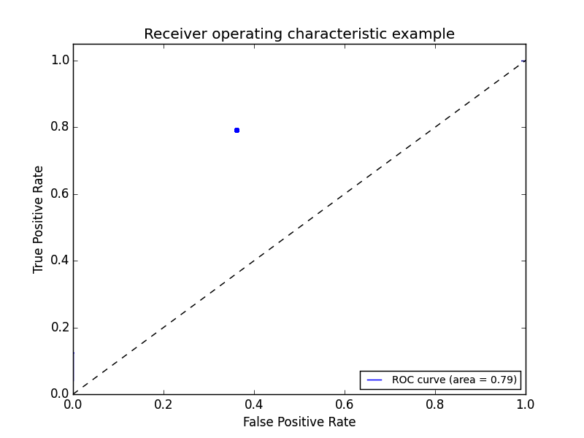
THE ROC CURVE
We can begin by plotting an individual TPR/FPR pair for one threshold.
Let’s say this is for a default p = 0.5
43 | © 2019 General Assembly

Slide 44
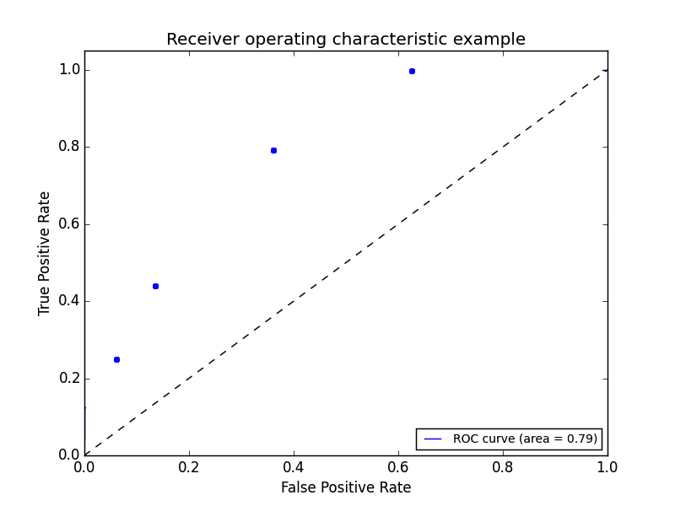
THE ROC CURVE
We can continue adding pairs for different thresholds.
Let’s say we wanted to set a probability threshold of p > 0.9. AKA I’m only making a prediction of class ‘0’ when the model outputs a probability that’s > 0.9.
- Which point would best represent this case?
44 | © 2019 General Assembly

Slide 45
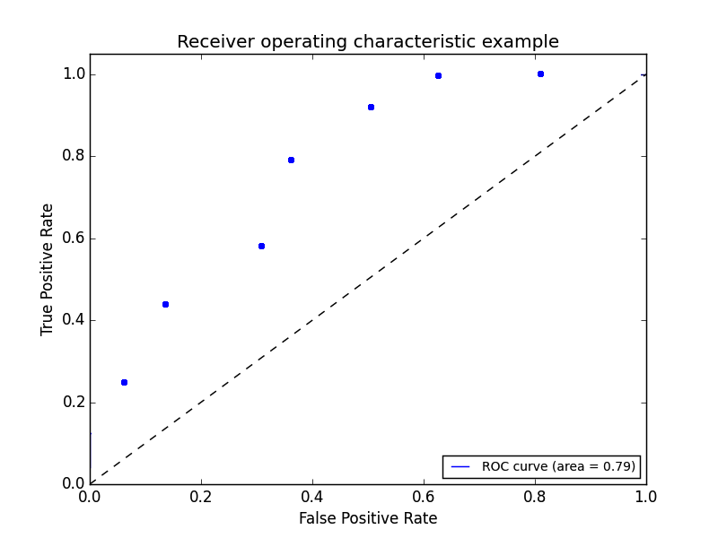
THE ROC CURVE
We can continue adding pairs for even more thresholds.
45 | © 2019 General Assembly

Slide 46
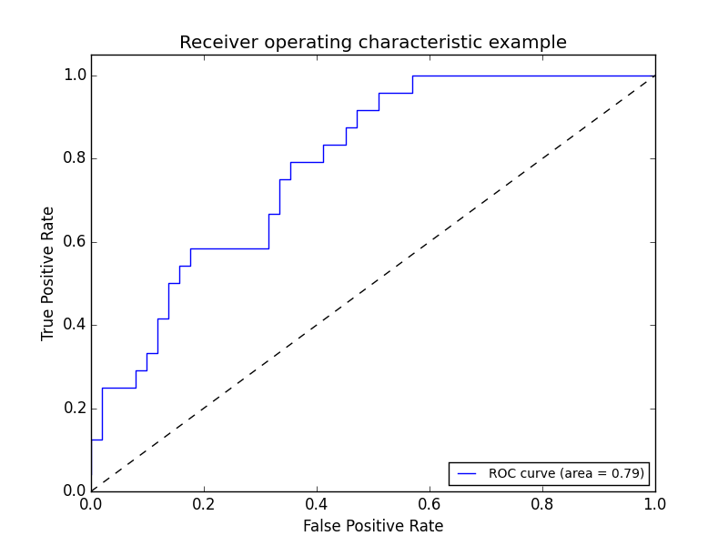
THE ROC CURVE
Finally, we create a full “curve” that is described by both TPR and FPR.
46 | © 2019 General Assembly

Slide 47
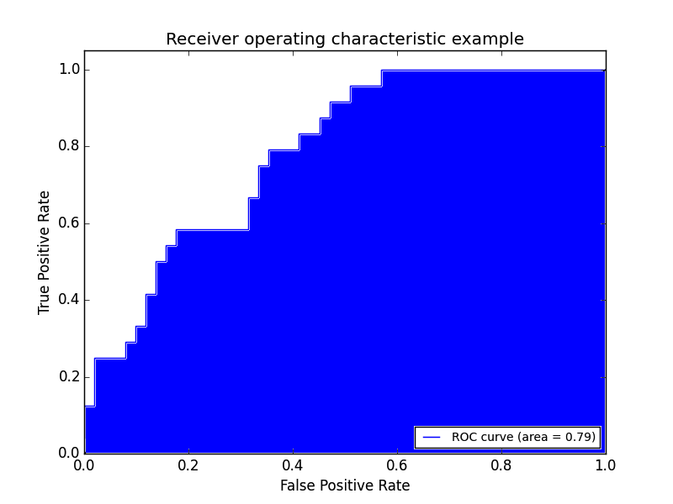
AREA UNDER THE CURVE
With this curve, we can find the Area Under the Curve (AUC).
As you increase your sensitivity (true positives) and can identify more cases with a certain condition, you also sacrifice accuracy on identifying those without the condition (specificity).

